Slide 1

DriverPass System Analysis
Jordan Barnes
Notes:
[No speaker notes required for this slide.]

Slide 2

System Requirements
Functional Requirements:
Administrative Service
User Registration Service
User Portal Service
Non-Functional Requirements:
Usability
Scalability
Notes:
Non-Functional Requirements:
Security:
Data integrity and user authentication need to be integrated. As a web-based product SSL and HSTS should be required to interact with the services. It is typically recommended to use a vetted third-party software to manage security.
Data Storage:
Our system must be able to store large amounts of data and efficiently retrieve that data when needed.
Availability:
Students/faculty need to have a central notification center to be advised of system downtime, holidays, class schedule variance, etc.
Functional Requirements:
User Portal Service:
Registered users need to be able to manage their personal settings, classes, and other details.
User Registration Service:
Users (Potential students, incoming students, and faculty) need to be able to register and be assigned to courses or elect courses themselves.
- Administrative Service:
Administrators of the software need to be able to edit, remove, or add authorization to students, teachers, IT personnel, etc.

Slide 3
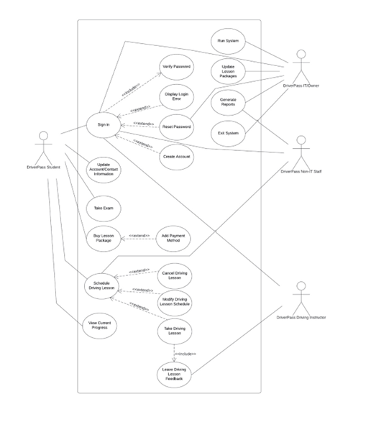
Use Case Diagram
Notes:
This use case diagram shows how users will interact with each other. First the user signs in or registers. They’ll make any necessary updates to their user information to keep it up to date.
The student will then have access to view courses, take assessments, and book by the calendar.
Once the student books a session with the calendar, the instructor will receive a notification that they have a session and give them a notification saying one of their slots is reserved. The student then preforms the behind the wheel and the instructor takes notes on the process.
Once the student takes all the required behind the wheel sessions and assessments, they then can proceed to the DMV to take a Test. After the test is complete the user gets their drivers license and no longer needs to use DriverPass. An administrator oversees all the processes in DriverPass and edits them based on the DMV’s industry best standards that are communicated to the admins.

Slide 4
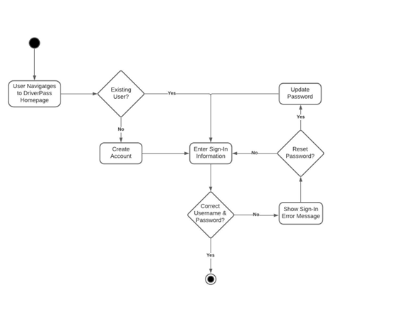
Activity Diagram
Notes:
This activity diagram describes the login process for a user. It will determine if the user is already registered and branch from there. If they are registered it will check security protocol to see if the user is required to update their password else they will sign in. It checks if the sign in information is correct and authorizes them. If they are not an existing user it branches to the registration page.

Slide 5
Security
Security:
Different authorities with varied access and accountability (Admin, User, Instructor, Etc.)
Notifications provided upon security breaches or policy breaches
OAuth registration
2FA optional
SSL and TLS will be required
Password cryptography at the system level
Notes:
I have suggested a multi-layered security protocol. This includes 2FA for accounts that are opted for it, Open authorization registration, authorities based on access level, notifications that are immediately sent to all appropriate administrators and system technicians, SSL and TLS encryption to ensure all web traffic is secure, and system level password encryption with a modern cryptographic protocol. This will ensure that passwords and data communication is secure.

Slide 6
System Limitations
Modern hardware
Internet Access
Contact
Access
Notes:
Unfortunately, our system does have limits that we need to make aware of when we are designing DriversPass.
First, users learning speed is marginally limited by their hardware. A person with a substandard internet connection will not be able to go through course material nearly as fast as someone with gigbit internet connection and modern processing units.
Another limitation that DriverPass has is that users must be able to access the internet to use effectively. To get past this, we can allow users to download files to preview content momentarily if they are anywhere where they cannot receive content.
Person to person Interaction is also limited, this causes a lack of effort for instructors to help students during coursework. However, during driving sessions the student will still be required to drive with an instructor in person to get a person to person learning experience.
With any web-based platform, you will have access issues. Thankfully most libraries carry modern equipment and internet connection allowing users the ability to use your platform.

